Slide 1

INSURANCE ANALYTICS

Slide 2
Contents
INSURANCE ANALYSIS
KPI LIST
EXCEL
POWER BI
TABLEAU
MY SQL
FOCUS ANALYSIS
CHALLEGES

Slide 3
INSURANCE ANALYSIS
An Insurance Analytics Dashboard project focuses on visualizing key insurance metrics to help insurers make data-driven decisions. The dashboard integrates data from various sources, providing insights into claims, policies, customer demographics, risk assessment, and fraud detection , Target, Revenue Tracking .
Develop a user-friendly dashboard for monitoring insurance KPIs.
Enhance data-driven decision-making in underwriting, claims processing, and
customer management.
Claims Analysis: Track claim frequency, severity, and processing time.
Fraud Detection: Identify suspicious claims using predictive analytics.
Risk Assessment: Evaluate underwriting risk and claim probability.
Insurance analysts, underwriters, claims managers, and executives.

Slide 4
KPI List
1-No of Invoice by Account Exec
2-Yearly Meeting Count
3.1Cross Sell--Target, Achieve, new
3.1New-Target,Achive,new
3.1Renewal-Target, Achieve , new
4. Stage Funnel by Revenue
5. No of meeting By Account Exe
6- Top Open Opportunity

Slide 5
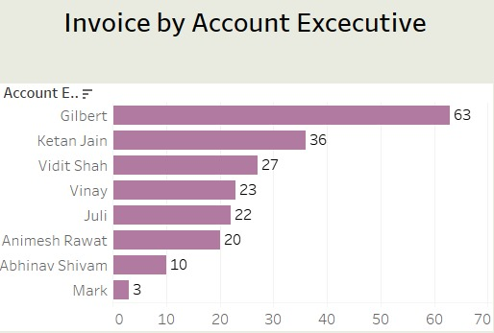
KPI 1
Title & Purpose: The chart is titled "Invoice by Account Executive," indicating that it represents the number of invoices processed by each account executive.
Horizontal Bar Chart: The chart uses horizontal bars to compare invoice counts across different executives.
Leading Performer: Gilbert has the highest number of invoices at 63, significantly higher than others.
Second & Third Place: Ketan Jain follows with 36 invoices, and Vidit Shah is third with 27 invoices Mid-Level Performers: Vinay (23), Juli (22), and Animesh Rawat (20) have moderate invoice counts Lower Contributors: Abhinav Shivam (10) and Mark (3) have the least invoices.
Insights: Gilbert is the top performer with almost double the invoices of the second-highest, while Mark has the lowest count.

Slide 6
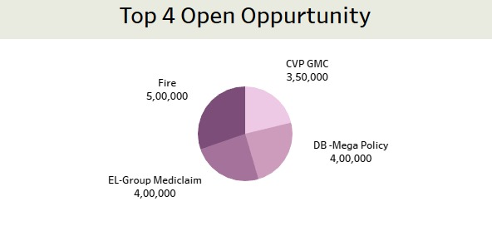
KPI 2
This is a pie chart that represents the top 4 open opportunities in terms of revenue potential . It helps visualize the relative contribution of each opportunity to the overall pipeline . Opportunities & Their Values Fire ₹5,00,000 (largest open opportunity).
EL-Group Mediclaim: ₹4,00,000.DB - Mega Policy ₹4,00,000.
CVP GMC: ₹3,50,000 (smallest among the top 4).
Insights from Data The Fire opportunity is the largest, contributing the highest revenue potential.
The EL-Group Mediclaim and DB - Mega Policy opportunities are equal, making up a significant portion of the pipeline . The CVP GMC opportunity is slightly lower, but still among the top four . Business Implications

Slide 7
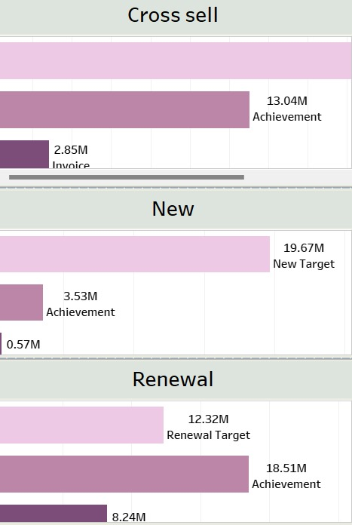
KPI 3
Cross Sell /Target /Achievement/
Achievement: 13.04M (moderate progress).
Invoice: 2.85M (much lower than achievement)
.Insight Although 13.04M has been achieved, the actual invoiced amount is significantly lower at 2.85M, indicating a gap between achievement and invoicing.
2. New Business Growth Representation New Target: 19.67M (goal to be reached).Achievement: 3.53M (very low compared to the target).Invoice: 0.57M (even lower than achievement).
Insight The company has only achieved 3.53M against the 19.67M target, which is far below expectations
The invoice amount is extremely low at 0.57M, which could indicate slow revenue recognition.
3. Renewal Business Representation Renewal Target: 12.32M.Achievement: 18.51M (significantly exceeding the target).Invoice: 8.24M (decent invoicing compared to achievement).Insight The renewal target is well surpassed, showing strong performance The invoice amount (8.24M) is lower than the achievement (18.51M), indicating that some revenue may still be in the pipeline.

Slide 8
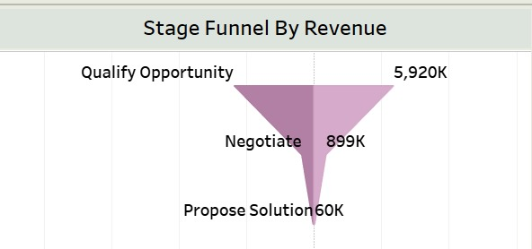
KPI 4
The chart is a funnel chart that represents revenue at different sales stages It visually depicts how revenue potential decreases as deals progress through the sales funnel Stages funnel by Revenue Values .
Qualify Opportunity: 5,920K (Highest revenue potential at the initial stage).
Negotiate: 899K (Significant drop in revenue potential).
Propose Solution: 60K (Very small revenue amount left at the final stage).
Another sharp decline from 899K to 60K at the Propose Solution stage, indicating that very few deals successfully convert into final proposals .
Possible Interpretations The sales team may struggle in closing deals after the qualification stage .
There may be issues in negotiations or customer objections leading to high drop-off rates. There is an opportunity to improve conversion rates between stages to retain more revenue potential.

Slide 9
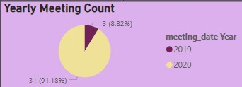
KPI 5
Title & Purpose: The chart is titled "Yearly Meeting Count," indicating that it represents the number of meetings held in different years.
Pie Chart Representation: A pie chart is used to show the proportion of meetings held in 2019 and 2020.
Majority of Meetings in 2020:31 meetings (91.18%) were conducted in 2020 (represented in yellow).
Fewer Meetings in 2019:Only 3 meetings (8.82%) took place in 2019 (represented in dark purple).
INsight There was a significant increase in meetings in 2020 compared to 2019, indicating possible changes in operations, business needs, or external factors that led to more meetings.

Slide 10
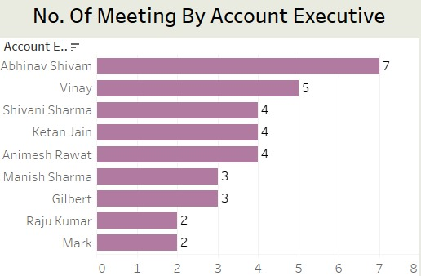
KPI 6
This is a horizontal bar chart displaying the number of meetings conducted by each account executive.
It helps assess the engagement level of different executives based on their meeting counts .
Top Performers Abhinav Shivam leads with 7 meetings, indicating the highest level of client engagement .
Vinay follows with 5 meetings Moderate Performers
Shivani Sharma, Ketan Jain, and Animesh Rawat each conducted 4 meetings .
Manish Sharma and Gilbert both had 3 meetings
Lowest Meeting Counts Raju Kumar and Mark had the least meeting The company may need to analyze why some executives have lower meetings and take steps to improve their engagement.

Slide 11
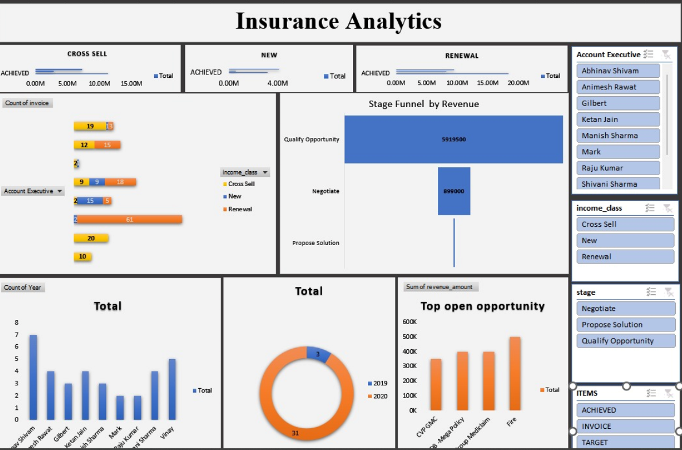
EXCEL DASHBOARD

Slide 12
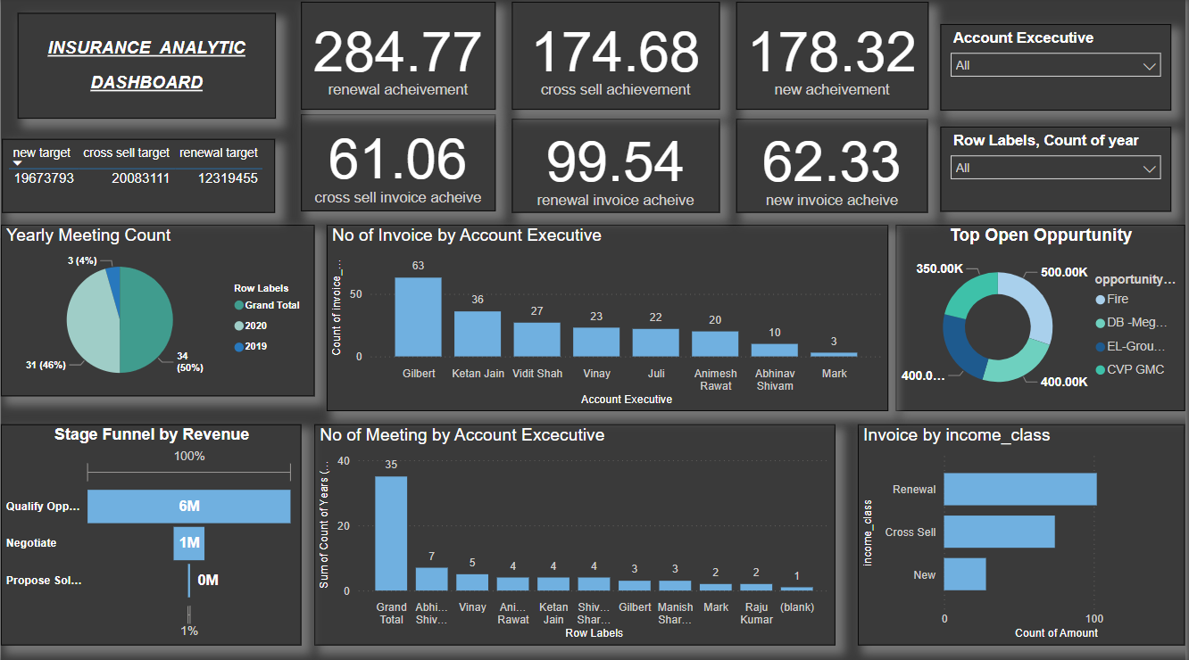
POWER BI DASHBOARD

Slide 13
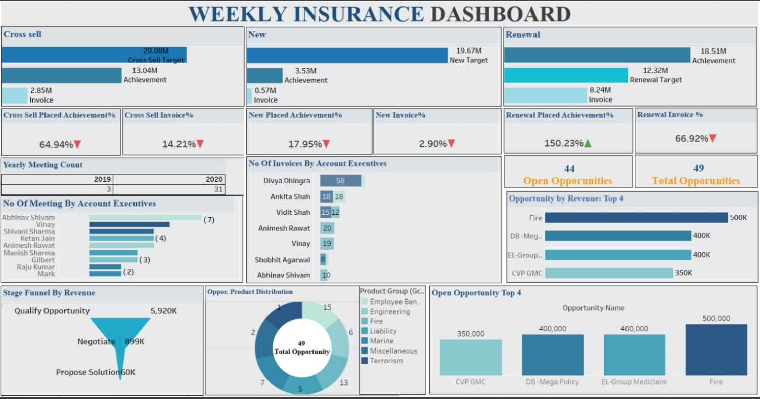
TABLEAU DASHBOARD

Slide 14
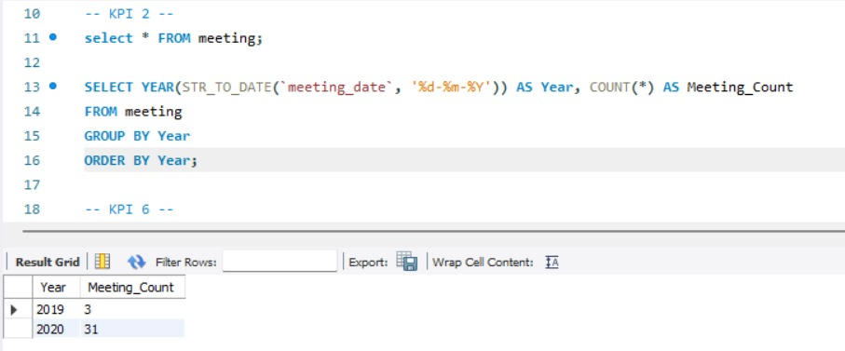
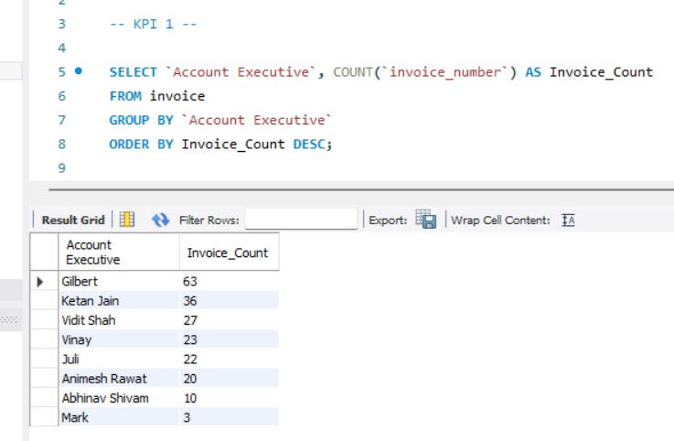
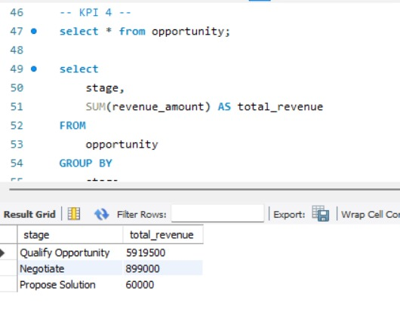
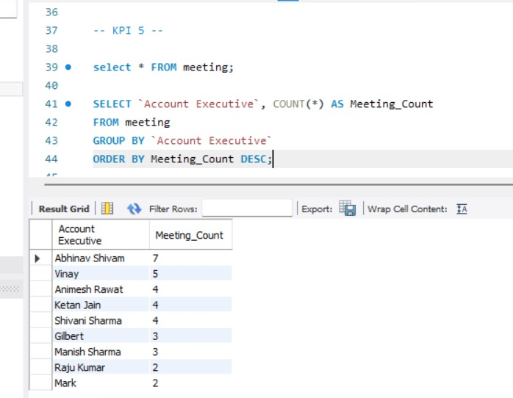

Slide 15
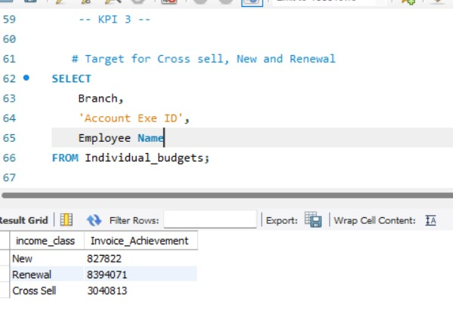
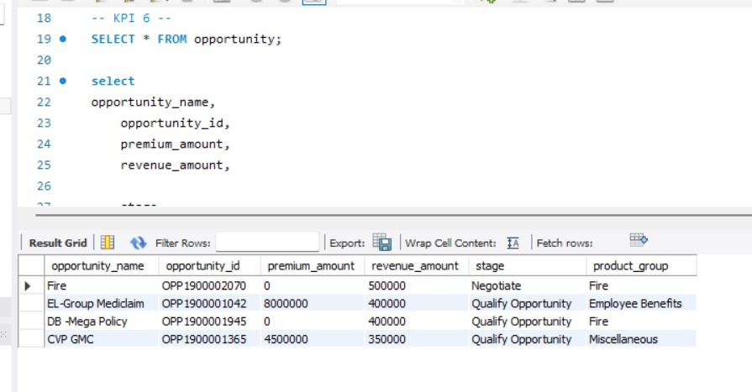

Slide 16
Focus Analysis
Claims Performance Monitoring
Policy & Customer Insights
Operational Efficiency
Comprehensive Claims Analysis
Fraud Detection & Prevention
User-Friendly Data Visualization
Predictive Analytics for Business Growth
Benchmarking & Competitive Analysis

Slide 17
CHALLEGES
Formula Errors: Complex formulas (VLOOKUP, INDEX-MATCH, Power Query) lead to errors.
DAX Complexity: Writing complex DAX formulas for advanced analytics.
Performance Optimization: Extract vs Live Connection issues with large datasets.
Performance Optimization: Writing efficient queries for large datasets.

